Slide 1
Defining and Publishing
Translational Medicine
Katrina l. kelner, phd
Editor, science translational medicine
Science family of Journals
Kiki forsythe, MLS
Senior publishER Relations specialist
Science family of Journals
Notes:
Thank you so much for inviting me to speak to you today. I am delighted to be here at the Chinese Academy of Medical Sciences.

Slide 2
Translational and Precision Medicine
The expanding Science family of journals (Kiki Forsythe)
Publishing in Science journals
Notes:
This afternoon, we have broken our talk into three parts. First I will give some remarks about Translational Medicine and its importance for improving human health. Then my colleague Kiki Forsythe, our Senior Publisher Relations Specialist will spend some time introducing you to the Science Family of journals. Then I will finish by giving you some hints about publishing your research in high-quality top journals.

Slide 3
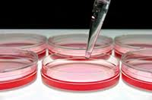
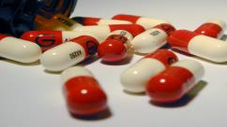
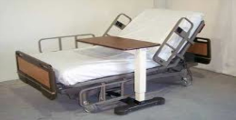
Defining Translational Research: Standard Definition
BASIC
BIOMEDICAL
RESEARCH
PRECLINICAL
RESEARCH
CLINICAL
TRIALS
IMPLEMENTATION
BENCH
BUSINESS
BEDSIDE
Notes:
In 2009, Science first started the journal Science Translational Medicine and in the following years, we have thought very carefully about the definition of translational medicine. At that time, the usual idea was that the process of developing new drugs and devices for improving the practice of medicine was a linear one. Fundamental and basic biomedical research into biological processes, including molecular and cell biology, was applied to preclinical research, usually animal model studies, and these then led to clinical trials by pharmaceutical companies and finally implementation and adoption of new drugs and devices in the clinic. Another way to characterize this linear process was Bench (the lab) to Business (pharmaceutical companies) to Bedside (the patient).
But in fact, successful translational is more complicated than this.

Slide 4


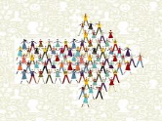
Defining Translational Research:
More Complicated Definition
Research that moves basic and preclinical biomedical or engineering science discoveries toward improved patient care
Clinical observations that are moved back into the research lab for mechanistic studies
The use of research findings to inform policy changes that affect community health and heath care
Notes:
As we learned more, our definition of translational research expanded. Yes, it still encompasses Research that moves basic and preclinical biomedical science discoveries toward improved patient care but we must also include ENGINEERING WHICH HAS MUCH TO CONTRIBUTE TO TRANSLATIONAL MEDICINE
ALSO some of the most successful translation has come from physician scientists who start with the patient. They make careful clinical observations and then are able to formulate hypothesis (derived from the patient) and test these hypotheses in the laboratory. One simple example of this approach is to determine the genetic cause of a disease in humans and then to make a genetically engineered mouse that carries this same mutation. This animal is often a very good mimic of the human disease and information derived from the genetic mouse model can be used to predict what will happen in human patients.
This gets around a very serious problem in translational medicine. Most animal models do not accurately represent human patient. Therefore the results from experiments in these animal models or tests of drugs in these animal models do not accurately predict what will happen when the same thing is done in human patients.
Finally we have realized that one very important aspect of translational research is to use research finding to inform policy changes that affect community health and heath care

Slide 5

Translation: The Road is Long
SLOW:
EXPENSIVE:
HIGH FAILURE RATE:
NUMBER OF NEW DRUGS:
PROBLEM:
Average time to approval, 10 y
Cost per successful drug: $4B
1 in 40 (not 1 in 10) drug
candidates reach clinic
27 FDA drug approvals in 2013
(only 9 first in class)
Limited access to patients
except during clinical trials
Notes:
Translational medicine is difficult AN THE ROAD IS LONG and some of the statistics surrounding this path are disheartening .
Read info on the slide
Why is this the case??

Slide 6

S
KNOWLEDGE
INNOVATION
REGULATORY
POLICY
Notes:
There are Gaps in the process. Here I have indicated 5 of the most problematic. CLICK CLICK CLICK i am going to say a few words about each one.

Slide 7

KNOWLEDGE GAP:
We don’t know as much about human biology as we thought we did
We must decipher the natural histories of human diseases and use this knowledge to select therapeutic targets and approaches
Progress requires investigations at the interfaces of established and emerging disciplines
Let’s give it a try. If all else fails, Sara has a corkscrew.
Notes:
The Knowledge gap. As it turns out, we don’t know as much about human biology as we thought we did
We must decipher the natural histories of human diseases and use this knowledge to select therapeutic targets and approaches. This is part of the importance of studying the patient to develop hypotheses that I mentioned before
Progress requires investigations at the interfaces of established and emerging disciplines
As this cartoon illustrates, we have to try everything

Slide 8
INNOVATION GAP:
Fear of risk
Lack of funding; rewards for safe science, not new ideas
Pharmaceutical and Biotech companies must satisfy shareholders and make profits
BEDSID
Notes:
What causes the innovation Gap?
Fear of risk Humans find it hard to take risks
Lack of funding; rewards for safe science, not new ideas
Pharmaceutical and Biotech companies must satisfy shareholders and make profits; this is not always consistent with innovative discoveries. Many of the new drugs approved by the FDA of the United States are small changes made to existing drugs: A different chemical version of a pill that delivers the drug more quickly but is not a new drug, for example.

Slide 9
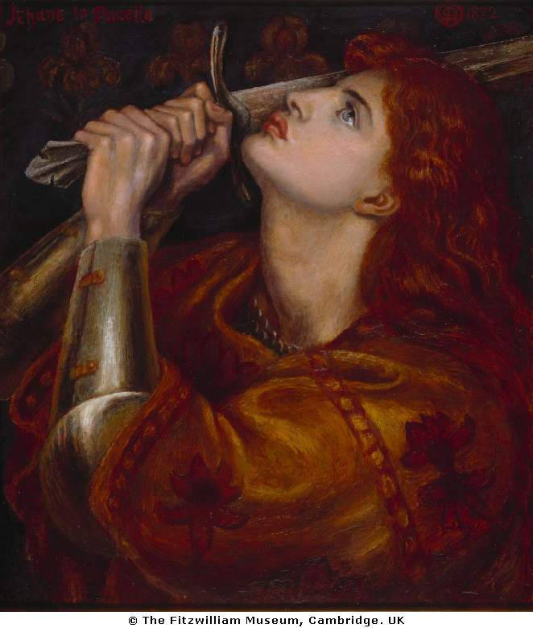
REGULATORY GAP:
Regulation is a bottleneck VS Regulation protects the public
Do we need to approve drugs and devices faster or be more vigilant about keeping potentially dangerous drugs off the market?
Challenge: We could do both at the same time if we could learn how to accurately predict, from preclinical data, the human health risks associated with a new product
“Ultimately, translational research requires a leap of faith because … there is always the risk of unanticipated adverse events.”
--Christopher Breuer, MD, Deputy Vice Chair of Research and Director, Tissue Engineering, The Ohio State University
Notes:
The REGULATORY GAP is caused by a tension between two ideas
Regulation is a bottleneck VS Regulation protects the public
The question is ‘Do we need to approve drugs and devices faster or do we need to be more vigilant about keeping potentially dangerous drugs off the market? Which is more important?
We could do both at the same time if we could learn how to accurately predict, from preclinical data, the human health risks associated with a new product. This is not an easy problem to solve.
As this quote from Christopher Breuer at Ohio State University says. “Ultimately, translational research requires a leap of faith because … there is always the risk of unanticipated adverse events.”

Slide 10
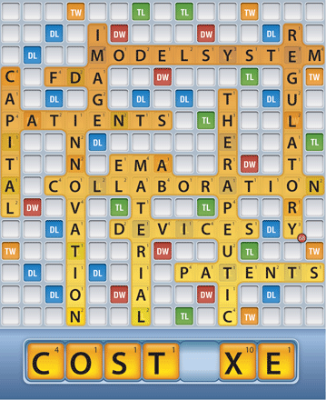
REGULATORY GAP:
What Is the Greatest Regulatory Challenge in the Translation of Biomaterials to the Clinic?
G. D. Prestwich et al., What Is the Greatest Regulatory Challenge in the Translation of Biomaterials to the Clinic?. Sci. Transl. Med. 4, 160cm14 (2012).
Notes:
And there is another problem. And as one Biomaterials Scientist said, the greatest regulatory challenge in translating biomaterials to the clinic is the COST of satisfying the regulators.

Slide 11
POLICY GAP:
FUNDING (e.g., ideas for early-venture funding)
EDUCATION (e.g., how to train the next generation of translational scientists)
REWARD SYSTEMS for team science (industry and academics)
GLOBAL HEALTH ISSUES (large philanthropic entities, the Gates Foundation)
REGULATORY OVERHAUL (requires government intervention)
stm.sciencemag.org/site/misc/current_policy_collection.xhtml
Notes:
Closing the Policy Gap requires action from administrators and the government. Here I have listed some of the areas where we are makin gprogress in solving some of the Policy problems.

Slide 12
Solutions
Make available to the world's scientists screening facilities, validated animal disease models, and chemical compound libraries
Earlier access to patients
Facilitate drug repurposing
B. Onaral, Emerging Economies, Enduring Partnerships. Sci. Transl. Med. 4, 158ed8 (2012).
Podcast: stm.sciencemag.org/content/4/158/158pc7.abstract
Notes:
The problems are complex but several changes have been suggested to contribute to the solution.
Make available to the world's scientists screening facilities, validated animal disease models, and compound libraries
Earlier access to patients
Facilitate drug repurposing

Slide 13
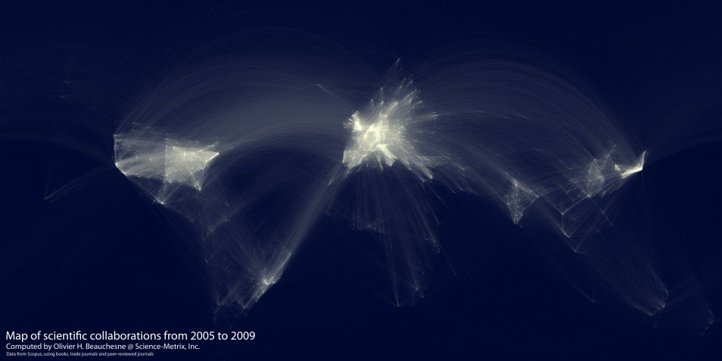
Collaboration
Europe
USA
China
Build worldwide innovation networks with diverse expertise
Make available to the world's scientists screening facilities, validated animal disease models, and compound libraries
Build worldwide innovation networks with diverse expertise
B. Onaral, Emerging Economies, Enduring Partnerships. Sci. Transl. Med. 4, 158ed8 (2012).
Podcast: stm.sciencemag.org/content/4/158/158pc7.abstract
Notes:
Collaboration. The more people, the more ideas. This slide illustrates the collaborations existing in the world between 2003 and 2009. The number would be more dramatic today. Centers of collaboration include the United States CLICK, Europe CLICK and China (which would show much more collaboration if the data were from 2015)

Slide 14
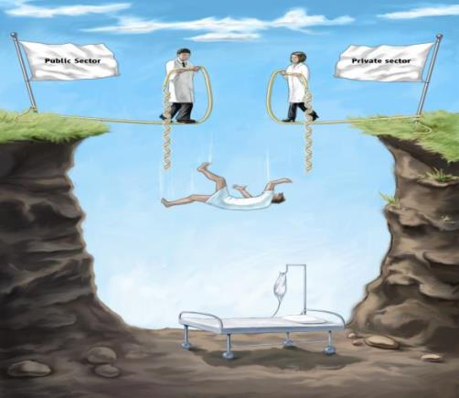
PUBLIC AND PRIVATE PARTNERSHIPS
“Share everything … Play fair.”
--Robert Fulghum
Notes:
Public and Private Partnerships. This is a humorous way to illustrate that when the Public Sector (government) and the Private Sector (Companies) don’t work together, the patient will suffer.

Slide 15

DATA SHARING
Sharing of knowledge drives science and innovation. It fosters cross-pollination, an essential driver of creativity
A proprietary culture threatens to stall the engine that has given us so many valuable treatments
Industry, academia, foundations, and government need to engage in collaborations early in the research process
Expand the precompetitive space!
Notes:
Data Sharing.
Sharing of knowledge drives science and innovation. It fosters cross-pollination, an essential driver of creativity
A proprietary culture threatens to stall the engine that has given us so many valuable treatments
Industry, academia, foundations, and government need to engage in collaborations early in the research process
We need to Expand the precompetitive space!

Slide 16
Successes
B. Onaral, Emerging Economies, Enduring Partnerships. Sci. Transl. Med. 4, 158ed8 (2012).
Podcast: stm.sciencemag.org/content/4/158/158pc7.abstract
Notes:
Where have we made progress? I want to give you some examples where over the last 5 years, we are seeing impressive translation.

Slide 17
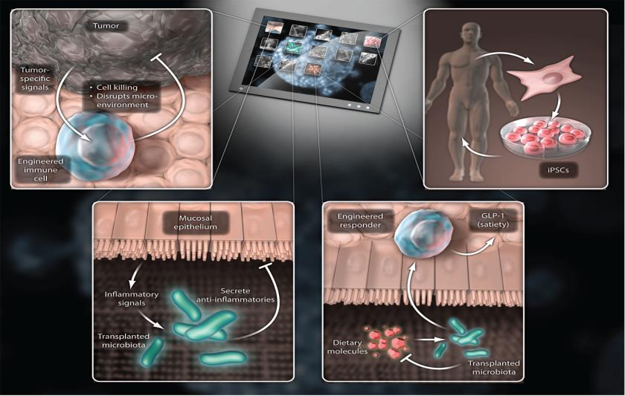
Cell-based Therapeutics
Tumor
Immunotherapy
iPSCs
Engineered
microbes
Engineered
microbes
Notes:
We have learned to engineer living cells so that they can serve as therapeutics themselves. Tumor immunotherapy has been a most exciting area of research, with engineered T cells proving effective in a number of blood cancers. iPSCs are cells that are engineered to become pluripotent and then coaxed to differentiate into a cell type needed for therapies. Not in the clinic yet, they are being actively investigated. And finally in the two panels at the bottom, I show that microbes like bacteria now known to be essential for human health can be engineered to deliver therapeutic products while they are resident in the human gut.

Slide 18
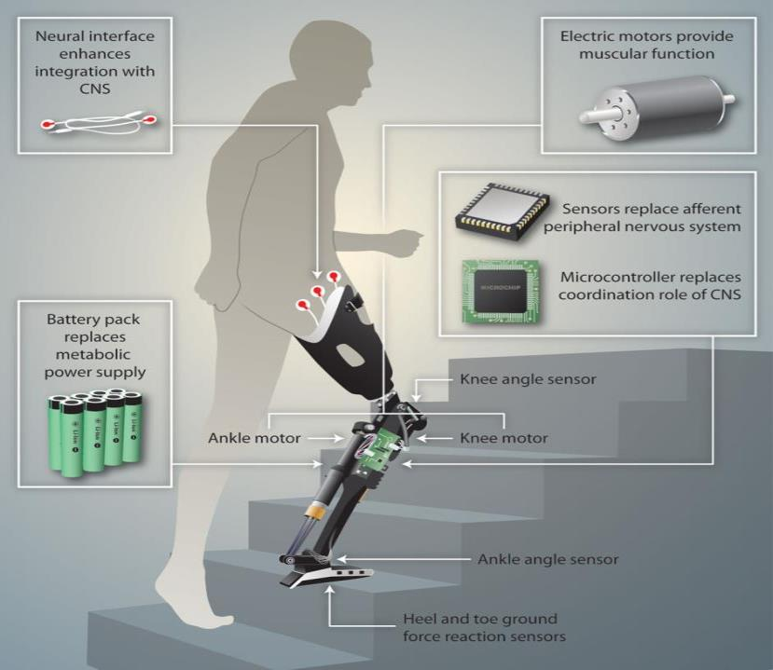
NEUROPROSTHETICS
Notes:
Advances in neuroprosthetics have been a triumph for engineering and neuroscience. In this illustration, an individual who has lost one leg has a neural implant connected to the nervous system in the leg that allows sensors in a mechanical artificial leg to send signals to the brain, simulating the natural situation in which one can not only control movement of a limb, but through the use of electronic sensors in the artificial leg the pateint can also sense pressure on the foot and can feel when the knee bends. These advances change his quality of life.

Slide 19
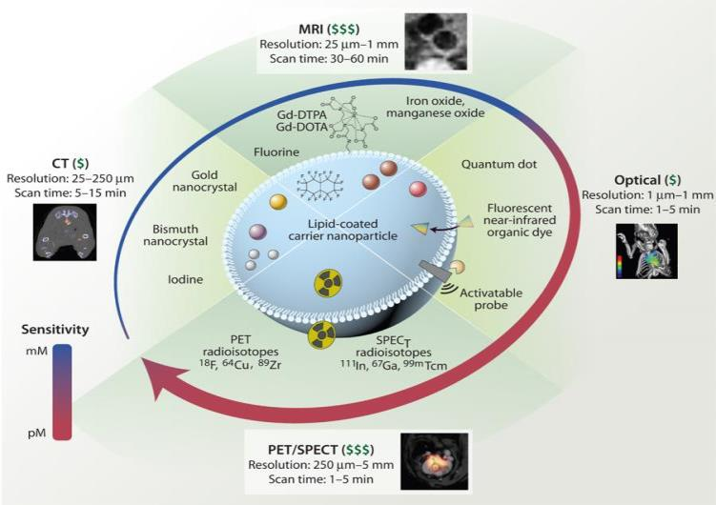
IMAGING THE LIVING HEART
Nanoparticle imaging and corresponding diagnostic modalities
Notes:
Advances in engineering nanoparticles for specific uses has revolutionized our ability to image the living heart. We now have an array of imaging agents that can be incorporated into a lipid coated carrier nanoparticle (shown here in the center of the diagram) to visualize the heart for many different diagnostic purposes. These nanoparticles allow PET or SPECT images with radioisotopes, optical images with quantum dots, MRI with contrast agents incorporated into nanoparticles and enhanced CT scans. This progress is an excellent example of how engineering can be harnessed for improved clinical care.

Slide 20
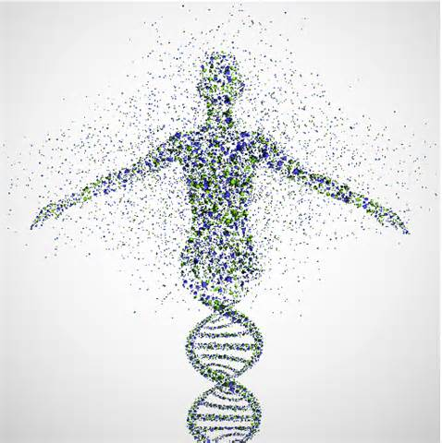
GENOMIC MEDICINE
PRENATAL
DIAGNOSIS
INCOMPLETE
PENETRANCE
GENETIC DISEASES
DISEASE
SUSCEPTIBILITY
PREDICTIVE
ANIMAL MODELS
CANCER
Notes:
And LAST BUT NOT least is our progress in the last 15 years that resulted from the sequencing of the human genome. Although we have not yet seen all of the benefits, but we have improved prenatal diagnosis of human diseasae, improved understanding of the cause of genetic diseases (and we know that many more diseases seem to have a genetic basis), our animal models based on human genetics are more predictive of human disease, we are beginning to understand classical genetic concepts such as incomplete penetrance and disease susceptibility at a molecular level – in humans. And although we have not solved the problem of cancer, we can definitely see further into the inner workings of this disease and understand much better the problems we need to solve to cure it. All thanks to our ability to sequence the human genome.

Slide 21
Precision Medicine
Emerging in the last 5 years
Notes:
Finally I want to talk a bit about Precision Medicine, a term that has just emerged to describe a new approach that has been enabled by biomedical advances in the last few years. What is Precision Medicine?

Slide 22
United States of America President Obama announces
the Precision Medicine Initiative Jan 30 2015
……an innovative approach to disease prevention and treatment that takes into account individual differences in people’s genes, environments, and lifestyles. Precision medicine gives clinicians tools to better understand the complex mechanisms underlying a patient’s health, disease, or condition, and to better predict which treatments will be most effective.
Notes:
In January of this past year 2015, President Obama proposed an initiative for Precision Medicine.
……an innovative approach to disease prevention and treatment that takes into account individual differences in people’s genes, environments, and lifestyles. Precision medicine gives clinicians tools to better understand the complex mechanisms underlying a patient’s health, disease, or condition, and to better predict which treatments will be most effective.

Slide 23
Precision Medicine
Epilepsy patients who carry an HLA-B*1502 gene should not receive the antiepileptic drug carbamazepine. This genetic marker predicts with high certainty that they will react to the drug with the deadly skin-blistering side effect “Stevens–Johnson syndrome” Another drug should be chosen.
The Genetics of the Individual Patient Guides Drug Selection
Carbamazepine, HLA-B*1502 and risk of Stevens–Johnson syndrome and toxic epidermal necrolysis: US FDA recommendations. PB Ferrell and HL McLeod, Pharmacogenetics 9, 1543 (2008)
Notes:
An old example and very simple of precision medicine was actually described in 2008. In this example, a single gene allele (HLA-B*1502) can predict with almost 100% certainty that patients given a particular drug carbamazepine for epilepsy will show a serious side effect, so they should not be given this drug.
Epilepsy patients who carry an HLA-B*1502 gene should not receive the antiepileptic drug carbamazepine. This genetic marker predicts with high certainty that they will react to the drug with the deadly skin-blistering side effect “Stevens–Johnson syndrome” Another drug should be chosen.
We can examine the genetics of a single individual and this information guides treatment of this patient.

Slide 24





Cancer leads the way for Precision Medicine
Gefitinib
Lung cancer Some patients recover, some do not
EGFR +
Gefitinib
Bisphosphonate plus rapamycin
K-RAS+
Two types of lung cancer Two precision treatments, all recover
Notes:
Cancer leads the way for Precision Medicine. In this example, I show the previous way we treated lung cancer. All patients were treated the same way, in this case lets say with the drug Gefitinib. But only some of the patients recovered, shown here by the green shapes. Many did not recover.
With precision medicine, we will have learned enough about cancer to group the lung cancer patients into two groups. One group had tumors that express the protein EGFR and the other KRAS. These two groups, when treated with two different and appropriate drugs, allow all of the patients to recover.
This example shows that Precision medicine will find exactly the right drug for each patient by understanding more about the specific type of cancer that each patient has. In this case Genetic Analysis will define the subtype of lung cancer

Slide 25
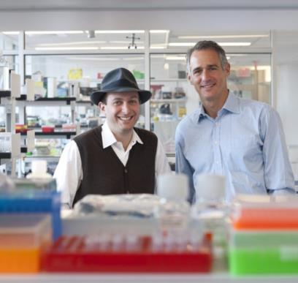

A patient with salivary gland cancer who had failed
conventional treatment sent cells from his tumor to
Foundation Medicine for testing. They were found to
show overactivity in HER2, a gene often defective in
breast cancer. This result suggested to the patient’s
doctors that his cancer would respond to Herceptin,
a drug often prescribed for breast cancer patients
Alexis Borisy (left) and Michael Pellini founded Foundation Medicine to determine the genetics of cancers for individual patients
Notes:
Here in this slide I show the founders of a company designed to deliver Precision Medicine solutions to cancer patients, called Foundation Medicine. A patient with salivary gland cancer who had failed
conventional treatment sent cells from his tumor to
Foundation Medicine for testing. They were found to
show overactivity in HER2, a gene often defective in
breast cancer. This result suggested to the patient’s
doctors that his cancer would respond to Herceptin,
a drug often prescribed for breast cancer patients
Understanding the genetics of the individual patient’s cancer allows accurate selection of an effective drug.

Slide 26
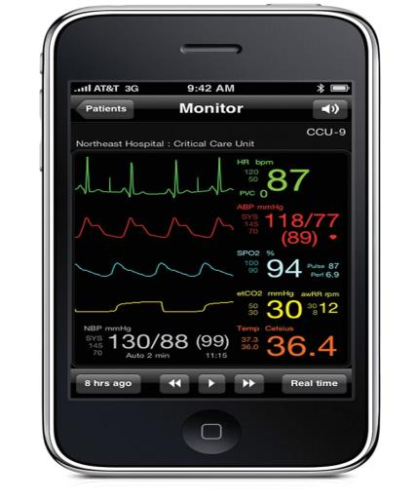

Digital Medical Devices
Remote continuous vital sign monitoring via iPhone. Delivers real-time data about the vital signs of any patient who is in a hospital intensive care unit to a doctor’s or nurse’s smart phone.
Published by AAAS
Notes:
In another example of Precision medicine, a phone based app can collect and analyze data from one individual to provide remote continuous vital sign monitoring. This app delivers real time data about the vital signs of a patient who is in a hospital intensive care unit to a doctor’s or nurse’s smart phone. Another instance of engineering improving medical care

Slide 27
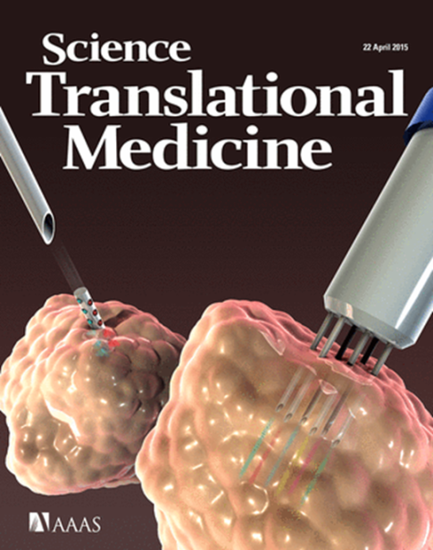
Another example of
personalized medicine
for cancer:
Inject many drugs into a
Tumor to find the most
effective
Notes:
Here is another example of precision medicine published in Science Translational Medicine. The article describes another new way to find out which drugs to give a patient. In this study the authors use a special device that can inject up to 6 different drugs directly into the tumor itself, while it is still in the patients’ body. A special many-pronged microneedle injected all of the test drugs and then the tumor was removed and by looking under a microscope, they were able to determine which drug most effectively killed the cancer cells. They could then use that drug to treat the patient. This is another example of personalized medicine.
Personalized medicine will also apply to diseases other than cancer. Asthma, for example. In the past, asthma was thought to be one disease. Now we know that there are many types of asthma. Researchers are now busy defining the different types of asthma and determining what treatments work best for each patient.

Slide 28
Other Precision Medicine Approaches
Personalized pharmacokinetics
Companion diagnostics for precision therapies
Nanotechnology for targeted therapies
Notes:
Other Precision Medicine approaches include:
Personalized pharmacokinetics for drug administration
Companion diagnostics for precision therapies
Nanotechnology for targeted therapies
I hope I have given you some idea of what Precision Medicine holds for the future.

Slide 30
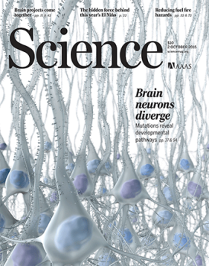



Submitting to the
Science Family of Journals

Slide 31


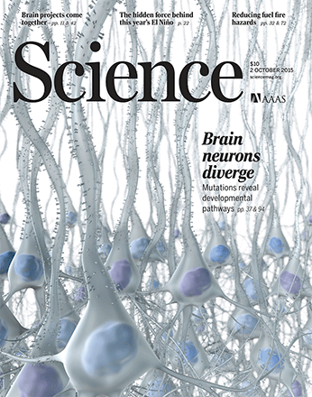
Interdisciplinary Science
Open Access
Online only
Research Articles
Full papers
Long format
Magazine
  News
  Research Articles
  Print and online
  Shorter format
Physics
Ecology: Cave fish without eyes
Materials Science
Biomedicine
Notes:
Our flagship journal is Science, which has been published since 1880. This journal contains News articles written by our talented reporters on subjects such as science funding, experiences of scientists in different countries, how AIDS is being fought in Africa and the latest research findings. In addition, the journal contains original research articles, written by the scientists themselves. These are the most important articles in all areas of science: physics, astronomy, ecology, biomedicine, molecular biology, chemistry. The journal is very interdisciplinary but publishes 15-20 articles a week, only the most important. It is published in print each week, and also online where we have new online features and news, appearing daily.
We have a second interdisciplinary journal, Science Advances. This journal is brand new as it started publication only in February 2015. It also publishes excellent articles from many different fields of science, ranging from physics to ecology. These articles are peer reviewed and are the same top quality as articles in Science but because Science is a small journal, we do not have room to publish them in Science. In Science Advances these papers can be published very quickly and be freely available to all readers. A key feature of Science Advances is that it is an Open Access journal. Instead of institutions paying a subscription for all of their staff members, the authors pay a fee if their paper is accepted for publication. Then immediately upon publication, anyone can freely read the paper on the Science Advances website.
To give you an idea of the sort of research that we publish, I have chosen two articles from Science and one from Science Advances to tell you about.

Slide 32
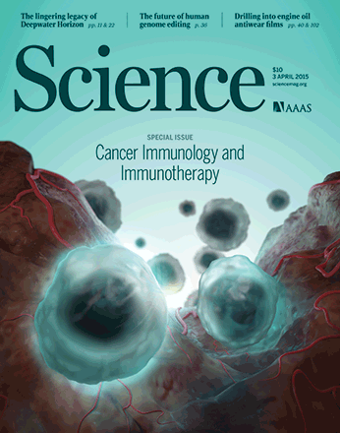
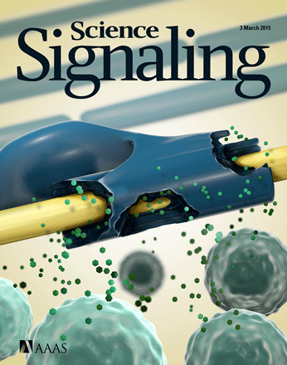


Comparing the four Science journals
Staff editors and Board of Reviewing Editors
Peer review for top quality
Reject, revise, accept
SUBSCRIPTION via INSTITUTION
PAPERS FREE AFTER 12 MONTHS
Academic editors
Peer review for top quality
Reject, revise, accept
OPEN ACCESS via AUTHOR FEE
PAPERS FREE IMMEDIATELY

Slide 33
Submissions and Acceptance Rate
Submissions/ >11500 >700 >2600 3000++
year
Acceptance 6% 19% 10% 16%
Papers/year ~800 ~150 ~250 ~250 to 500++

Slide 34
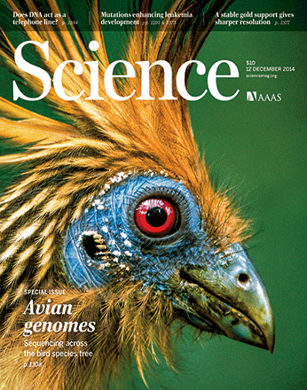
How to Publish in the Science Journals is NOT a secret
Read the Science Journals
Become a trusted, critical reviewer for the Science Journals
Work on important problems
Know when you have a reasonable result worthy of publication in a high-profile journal
Present the results of your work in an unbiased, dispassionate manner
Get some honest advice from impartial critics prior to submission

Slide 35
WHICH JOURNAL IS RIGHT FOR MY RESEARCH?
READ THE JOURNALS
BE FAMILIAR WITH WHICH JOURNALS PUBLISH PAPERS IN YOUR FIELD
LEARN WHAT MAKES A GOOD PAPER

Slide 36
Should I submit to Science?
ASK YOURSELF THESE QUESTIONS:
Is your finding a big step forward with broad implications?
Will many scientists find your results exciting?
Did you apply a new technique to investigate difficult scientific questions?
Is your research in the biological, physical, or social sciences?
Is your study self-contained and suitable for the Science format?
IF YOU ANSWERED YES TO THESE QUESTIONS, YOUR PAPER MAY BE SUITABLE FOR SCIENCE.

Slide 37
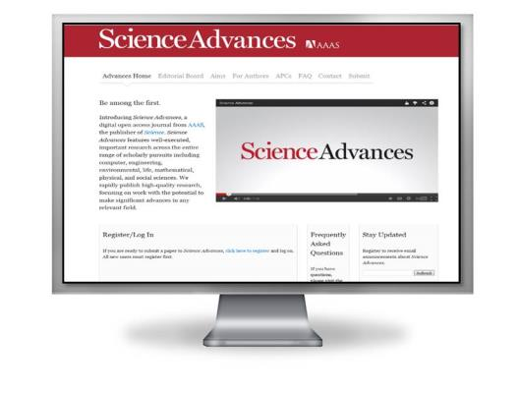
Should I Submit to Science Advances?
ASK YOURSELF THESE QUESTIONS:
Is your finding a step forward with a broad implication?
Will many scientists find your results exciting?
Is your research in the biological, physical, or social sciences?
Does your paper require a longer format?
Does your funding agency require publication in an open access journal?
Was your paper recommended for transfer from a Science journal?
IF YOU ANSWERED YES TO THESE QUESTIONS, YOUR PAPER MAY BE SUITABLE FOR SCIENCE ADVANCES.

Slide 38
Should I Submit to Science Translational Medicine?
ASK YOURSELF THESE QUESTIONS:
Does your research use basic science knowledge to make real progress toward improved patient care?
Does your research apply engineering discoveries toward improvements in clinical care?
Do you have strong evidence that your findings apply to human beings?
Does your research present novel ideas or approaches?
Was your paper recommended for transfer by Science or Science Signaling?
IF YOU ANSWERED YES TO THESE QUESTIONS, YOUR PAPER MAY BE SUITABLE FOR SCIENCE TRANSLATIONAL MEDICINE.

Slide 39
Should I Submit to Science Signaling?
ASK YOURSELF THESE QUESTIONS:
Are your results reporting a cellular or organismal signaling pathway:
  that helps understanding of physiology and disease?
  that helps understanding or treating disease?
  that is a novel type of signaling?
  with computational or modeling analysis leading to a tested prediction?
Was your paper recommended for transfer rom Science or Science Translational Medicine?
IF YOU ANSWERED YES TO THESE QUESTIONS, YOUR PAPER MAY BE SUITABLE FOR SCIENCE SIGNALING

Slide 40
YOU CANT GO WRONG
IF YOUR PAPER IS NOT SUITABLE FOR ONE SCIENCE FAMILY JOURNAL, WE WILL HELP YOU TRANSFER TO A MORE SUITABLE SCIENCE JOURNAL

Slide 41
Write a good cover letter
This is your chance to speak directly to the editor.
  Explain the overall context of your results. What problem do they solve?
  Explain why you are excited about your work.
  Keep it short, preferably 1 page.
Have someone else proofread and edit it, especially if English is not your first language.
If you are re-using your cover letter from submission of the paper to another journal, don’t forget to change the name of the journal!!!

Slide 42
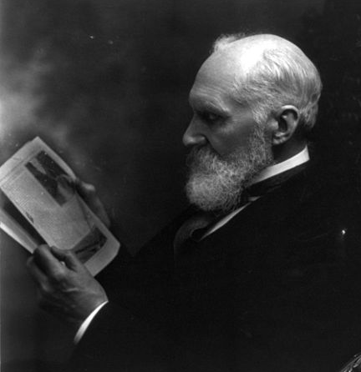
Think like a reviewer
Run your own review process
A scientist in your own specialty
A scientist in an unrelated specialty
A good editor for the English language

Slide 43
How to Publish in the Science Journals is NOT a secret
Read the Science Journals
Become a trusted, critical reviewer for the Science Journals
Work on important problems
Know when you have a reasonable result worthy of publication in a high-profile journal
Present the results of your work in an unbiased, dispassionate manner
Get some honest advice from impartial critics prior to submission
Notes:
Repeat what is on slide
I now want to make an exciting announcement

Slide 44
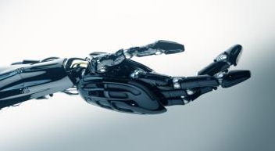
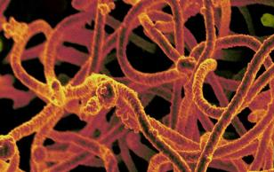
Announcing!
Two, new high-impact research journals from the publisher of Science
Publishing in 2016
Science Robotics
Science Immunology
A visible high-quality platform devoted exclusively to robotics research across the basic sciences, computer science, engineering, and medicine.
The exciting crossroads of cellular and clinical immunology where human research meets a full host of organisms.

Slide 46
China Publications in Science
Year | Submissions | Reviewed | Published
2010 | 735 | 50 | 14
2011 | 821 | 59 | 10
2012 | 859 | 77 | 11
2013 | 1106 | 91 | 23
2014 | 1103 | 98 | 12
Percentage going to review is increasing
Percentage publish up to 2014 still lags global average of 6%
But 2015 is excellent year: by early September have already published more papers from China than in all of 2014.

Slide 47
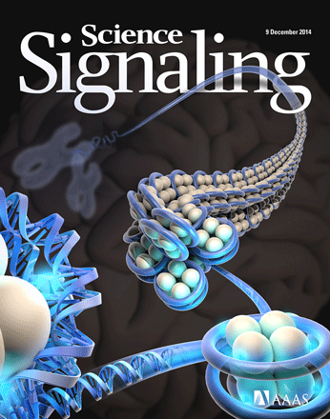
China Publications in Science Signaling
Year | Published
2010 | 10
2011 | 11
2012 | 13
2013 | 18
2014 | 24
Relative to 130 total papers published per year

Slide 48
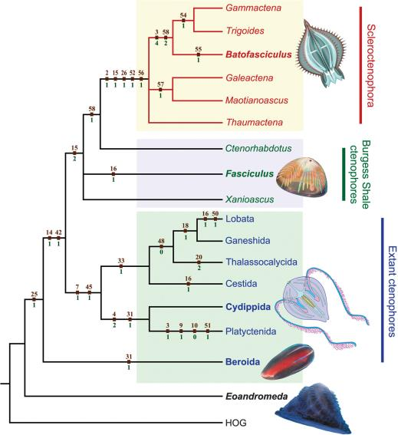
China Publications in Science Advances
26 published (out of 176, or about 15%)
16 additional in press
10 under review
222 rejected
A vanished history of skeletonization in
Cambrian comb jellies, by Ou et al.,
China University of Geosciences, Beijing.
Notes:
Published in July, article has been downloaded about 7000 times.

Slide 49
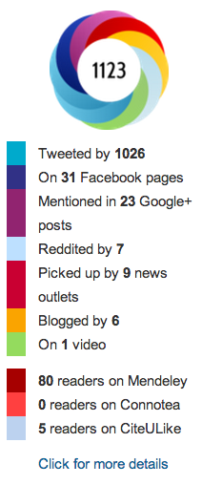
Standing out from the crowd
The past: Authors compete to get their papers published in high-impact journals; IF of journal considered a proxy for quality of paper.
The present: Increased use of citations, altmetrics; importance on raising visibility through conventional and social media
The future: Menu of options for demonstrating impact across the basic to applied spectrum, including predictive factors based on altmetrics; more emphasis on authors getting the word out.

Slide 50
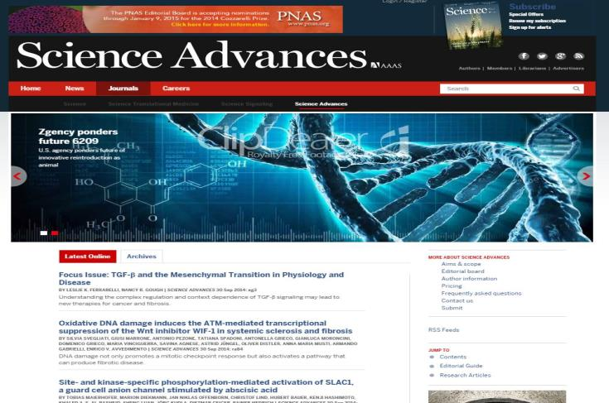
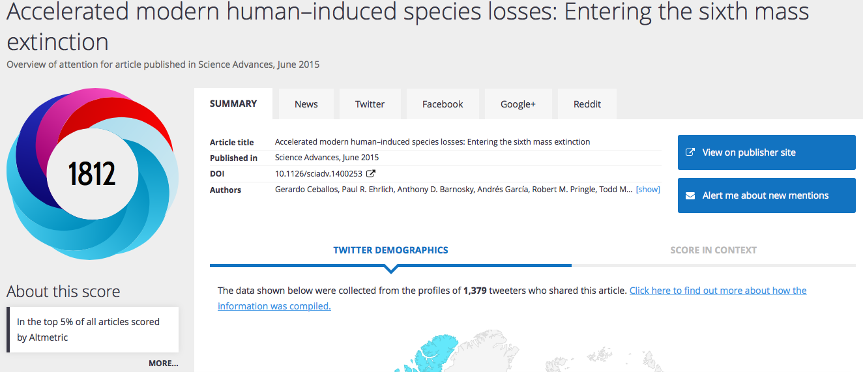
Notes:
It is the highest-rated paper from any journal that Altmetrics tracks, in context of its age. And it ranks #126 across all the 4 million plus papers ever tracked by Altmetrics, regardless of age.

Slide 51

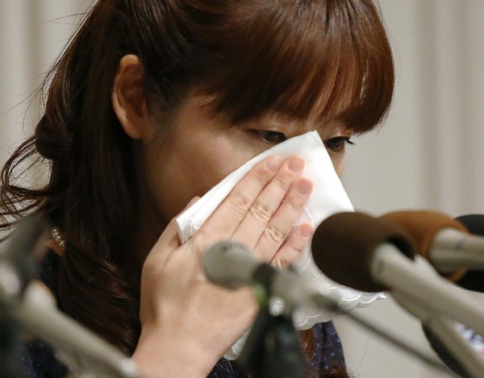
Standards of conduct
The past: Variations in interpretation of what constitutes COI, contributions worthy of authorship, etc. vary internationally.
The present: Journals increasingly stipulating expectations for conduct and asking authors and reviewers to sign declarations.
The future: The scientific enterprise will truly become one international community with a common set of standards practiced globally.
Notes:
Poster children for bad b

Slide 52

Addressing the overburdened reviewer system
The problem: Manuscripts undergo serial rejection from journals (down the “IF ladder”), leading to multiple rounds of review.
Solutions:
  Increasing use of decisions by editors
  Broaden reviewer pool (please register!)
  Cascading of manuscripts/reviews within journal families
  Growth of 3rd party review services that provide peer review and suggest target journals appropriate for the topic/quality of the manuscript

Slide 53
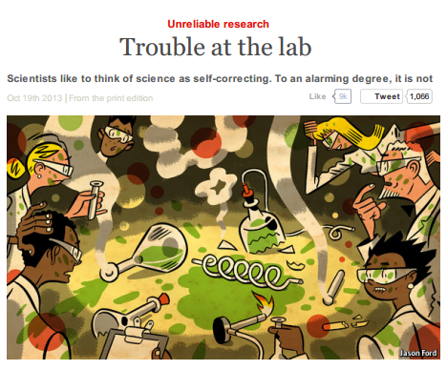
Trusting science
The past: Science assumed to be self-correcting. Irreproducible research would be weeded out. Fraudulent research assumed to be rare.
The present: Increasing attention on raising the standards for transparency and improving practices for open science.
The future: The scientific enterprise will truly become one international community with a common set of standards practiced globally.

